Slide 1

Amazon Analytics made Easy -Watch Collection Data Using GPT3, Streamlit By: Ram Rallabandi

Slide 2
Agenda
Introduction
Data Cleaning
Conclusion
Problem Statement
Data Collection
Data Analysis and Visualization
Data Modeling
Future Steps
Demo

Slide 3




Ram Rallabandi , M.B.A Data Scientist
Toronto, Ontario
+1-647-637-7889
ram89toronto@gmail.com
M.B.A
Marketing Research & Analytics -Centennial College
Data Science Immersive - General Assembly
Account Manager-Data Solutions Airtel
Account Manager- Canon Canada Inc.

Slide 4
Problem Statement
Amazon User: Static Search
Amazon Seller: No Insights on Competition
Manufacturer: Hard to find hidden trends

Slide 5
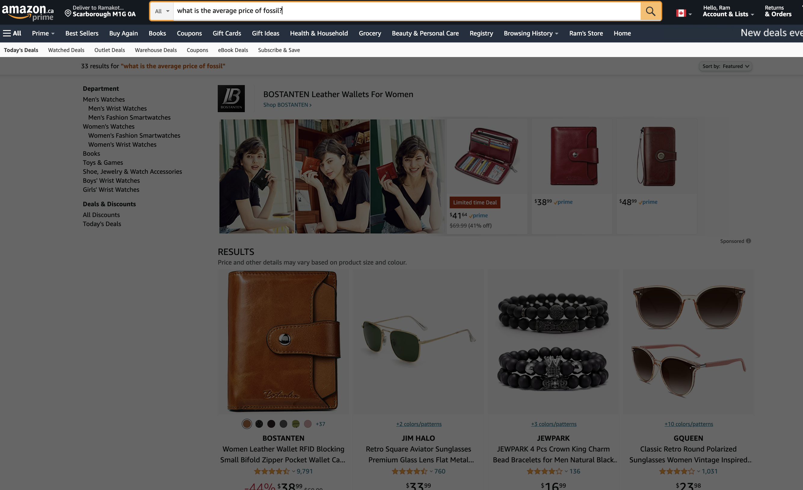
Current: Can't Answer “What is the average price of Fossil ?”

Slide 6
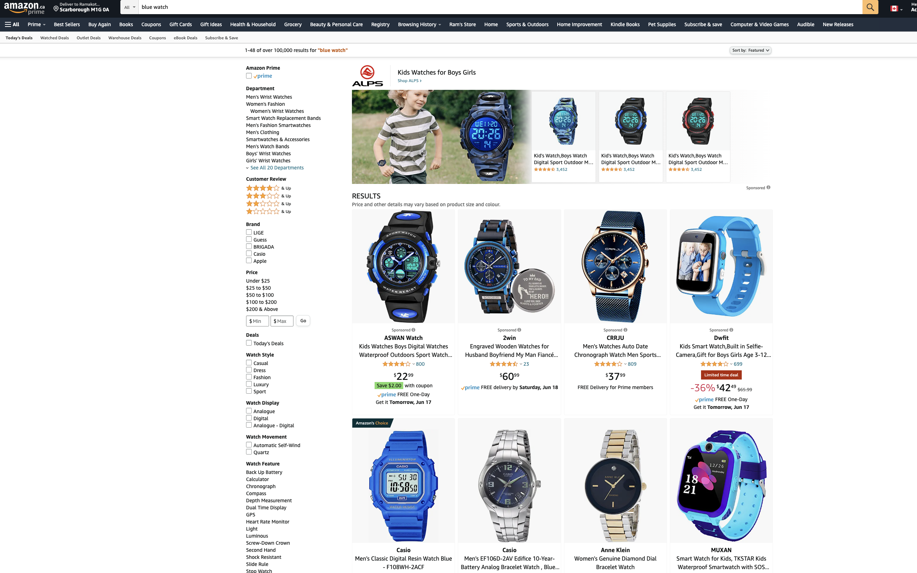
Current: Can’t show right results for ”Blue Watch”

Slide 7
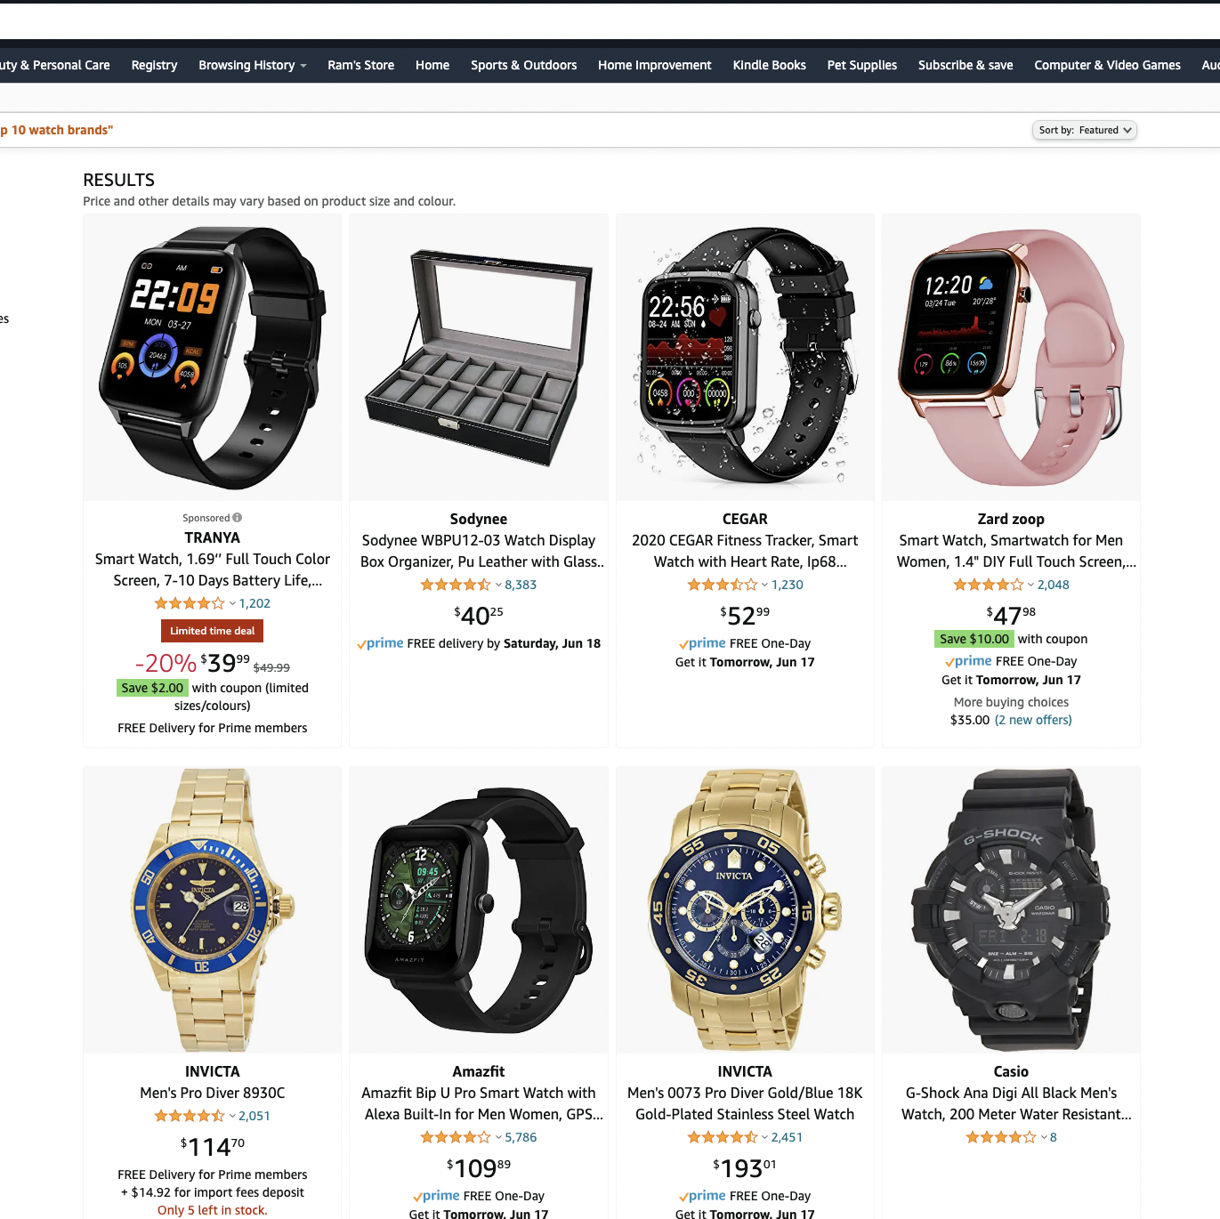
Current: Can’t show “Top 10 Watch Brands”

Slide 8
Key Points in answering the problem
Targeting the Audience
Personalized Customer Service
Personalize Product Recommendation
Dynamic Pricing
Notes: https://magnimindacademy.com/blog/how-do-i-use-machine-learning-to-gain-profit/

Slide 9
Data Collection
Amazon.ca
Libraries : BeautifulSoup, Selenium, requests, re
Data – 800 Pages of Watches collection

Slide 10
Data Cleaning
Data Type conversion – Int, Category, float
Removing Duplicates
Addressing the missing values

Slide 11
Data Visualization
Libraries – Wordcloud, pyplot_express, seaborn, matplotlib
Insights of top 10 in different graphs
Wordcloud, bargraphs, Images of watches

Slide 12
Data Modeling
Libraries – Opencv, sklearn, GPT3, Kmeans Clustering
Uses: ImageClassification, Natural Language Processing
Deployment- Streamlit , Git, Heroku

Slide 13
Future Concept
Auto labeling of databases using image recognition
Sample proof of concept to identify colors of uploaded image
Extending for multiple categories like shoes, apparel, furniture etc

Slide 14

DEMO

Slide 15
Conclusion – Generating Profitable application using ML and OpenAI
Natural Language to Python code for querying using GPT3
Easy Analysis for Sellers of Amazon
Helping Manufactures to identify color combinations that has higher ratings in designing watches

Slide 16
Thank You

